Slide 1



S. S. Education Trust’s
S. G. Balekundri Institute of Technology
Shivabasava Nagar, Belagavi - 590010, Karnataka, India.
Approved by AICTE, New Delhi & Affiliated to VTU, Belagavi
An ISO 21001:2018 Certified Institute | 5 UG Programs are NBA Accredited
Department of Computer Science Engineering
VISVESVARAYA TECHNOLOGICAL UNIVERSITY
Jnana Sangama, Belagavi, Karnataka
Bachelor of Engineering Internship Project
on
Front-End Web Development
Presented By
Name:Vivek Tigadi
USN: 2BU19CS057
Company Name
Hamdan InfoCom
Under the Guidance of
Guide Company Supervisor
(Prof.Siddharth Bhatkande) Mr. Mujahid Gokak

Slide 2
S. S. Education Trust’s
S. G. Balekundri Institute of Technology
Shivabasava Nagar, Belagavi - 590010, Karnataka, India.
Approved by AICTE, New Delhi & Affiliated to VTU, Belagavi
An ISO 21001:2018 Certified Institute | 5 UG Programs are NBA Accredited
Department of Computer Science Engineering
Contents
Internship Certificate
Introduction
Company description
Company profile
About the company.
Task performed
Methodology
Block diagram
Software and Hardware Required
Result
Advantages & Disadvantages
Applications
Conclusion and Future Scope
Internship Discussion
References

Slide 3

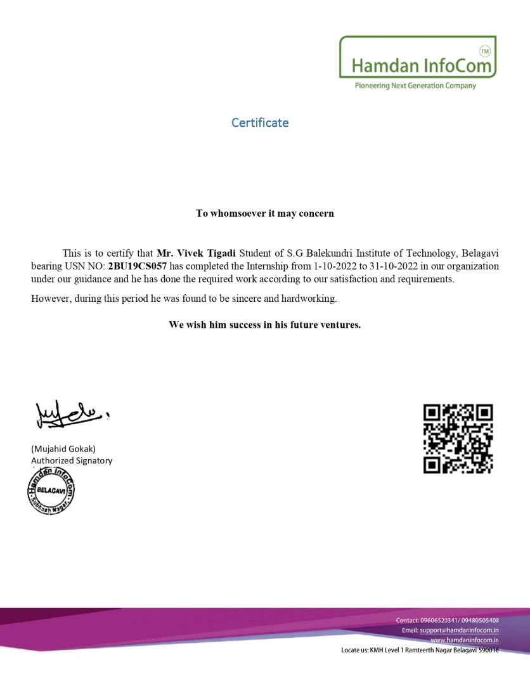
S. S. Education Trust’s
S. G. Balekundri Institute of Technology
Shivabasava Nagar, Belagavi - 590010, Karnataka, India.
Approved by AICTE, New Delhi & Affiliated to VTU, Belagavi
An ISO 21001:2018 Certified Institute | 5 UG Programs are NBA Accredited
Department of Computer Science Engineering
Internship Certificate

Slide 4


S. S. Education Trust’s
S. G. Balekundri Institute of Technology
Shivabasava Nagar, Belagavi - 590010, Karnataka, India.
Approved by AICTE, New Delhi & Affiliated to VTU, Belagavi
An ISO 21001:2018 Certified Institute | 5 UG Programs are NBA Accredited
Department of Computer Science Engineering
Introduction
Front-end web development is the process of creating webpages and applications that are interactive and visually appealing.
It involves creating the user interface, developing the user experience, and coding the web pages and applications. Front-end developers use HTML, CSS, and JavaScript to build beautiful, interactive websites and applications.

Slide 5


S. S. Education Trust’s
S. G. Balekundri Institute of Technology
Shivabasava Nagar, Belagavi - 590010, Karnataka, India.
Approved by AICTE, New Delhi & Affiliated to VTU, Belagavi
An ISO 21001:2018 Certified Institute | 5 UG Programs are NBA Accredited
Department of Computer Science Engineering
Company description
Company Name : Hamdan InfoCom
Founder & CEO : Mr.Mujahid Gokak
Hamdan InfoCom is a Software Startup company
Services
Take contracts to build websites for companies
Provides Internship for students with real time projects
Clients
Venugram Educational Institution

Slide 6


S. S. Education Trust’s
S. G. Balekundri Institute of Technology
Shivabasava Nagar, Belagavi - 590010, Karnataka, India.
Approved by AICTE, New Delhi & Affiliated to VTU, Belagavi
An ISO 21001:2018 Certified Institute | 5 UG Programs are NBA Accredited
Department of Computer Science Engineering
Task performed
We first created the basic layout and structure of the web page using HTML. This includes defining the HTML tags, elements, and attributes that will be used to display text, images, and other media on the page.
Next we applied styling and formatting to the HTML using CSS. This includes defining the layout, color scheme, font styles, and other visual elements of the page.
Then Bootstrap 4 is a popular CSS framework that provides pre-built UI components, such as buttons, forms, and navigation menus, that can be easily integrated into the web page.
JavaScript is used to add interactivity and dynamic behavior to the web page. This includes creating animations, responding to user input, and updating the content of the page without requiring a full page refresh.

Slide 7

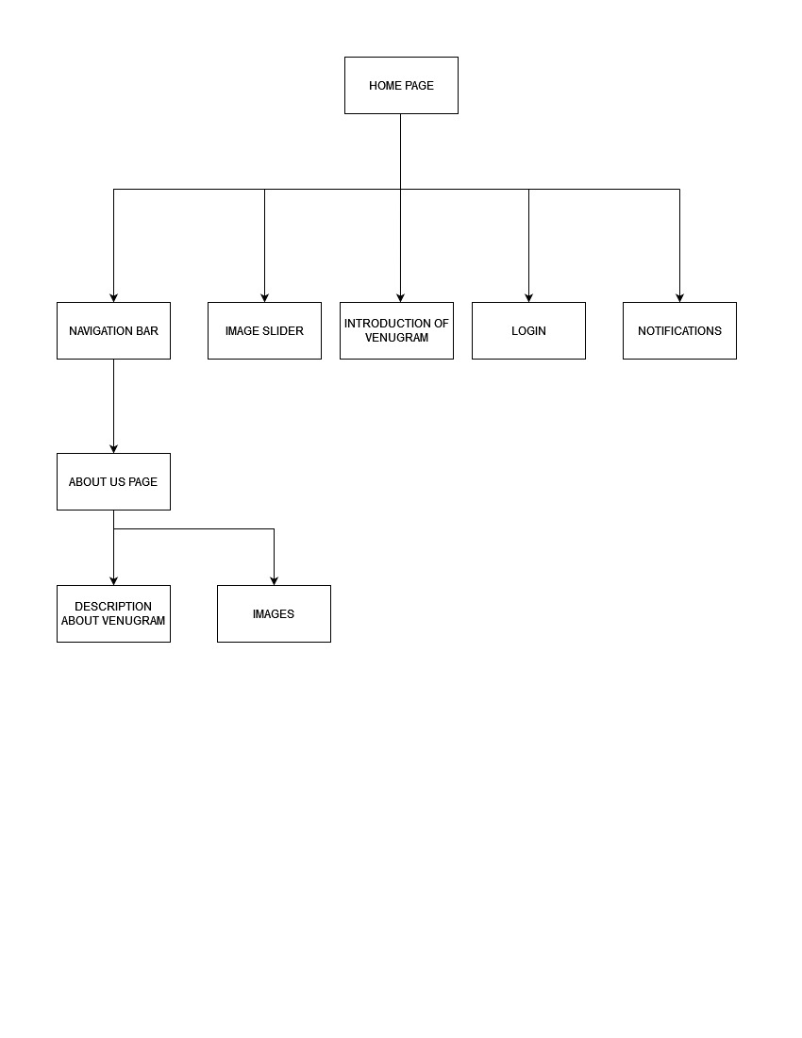
Methodology
Fig 1. Block Diagram of Venugram

Slide 8
Working Principle
User-centric design: Front-end development is focused on creating a user-friendly and intuitive user interface.
Responsive design: Websites should be optimized for different devices and screen sizes.
Cross-browser compatibility: Front-end developers should ensure that the website works consistently across different browsers and operating systems.
Accessibility: Websites should be accessible to all users. Front-end developers should follow web accessibility guidelines and standards to ensure that the website can be used by everyone

Slide 9
Hardware Requirements
PROCESSOR : Intel i3 or above
RAM : 4GB or above
HARD DISK : Min 256 GB
KEY BOARD : Standard Keyboard
MOUSE : PS/2 Mouse
MONITOR : Plug and play monitor

Slide 10
Software Requirements
TOOLS USED : VS Code
FRONT END : HTML, CSS, Java script and Bootstrap
SERVER : VS code live server
OPERATING SYSTEM : Windows 7/10/11

Slide 11
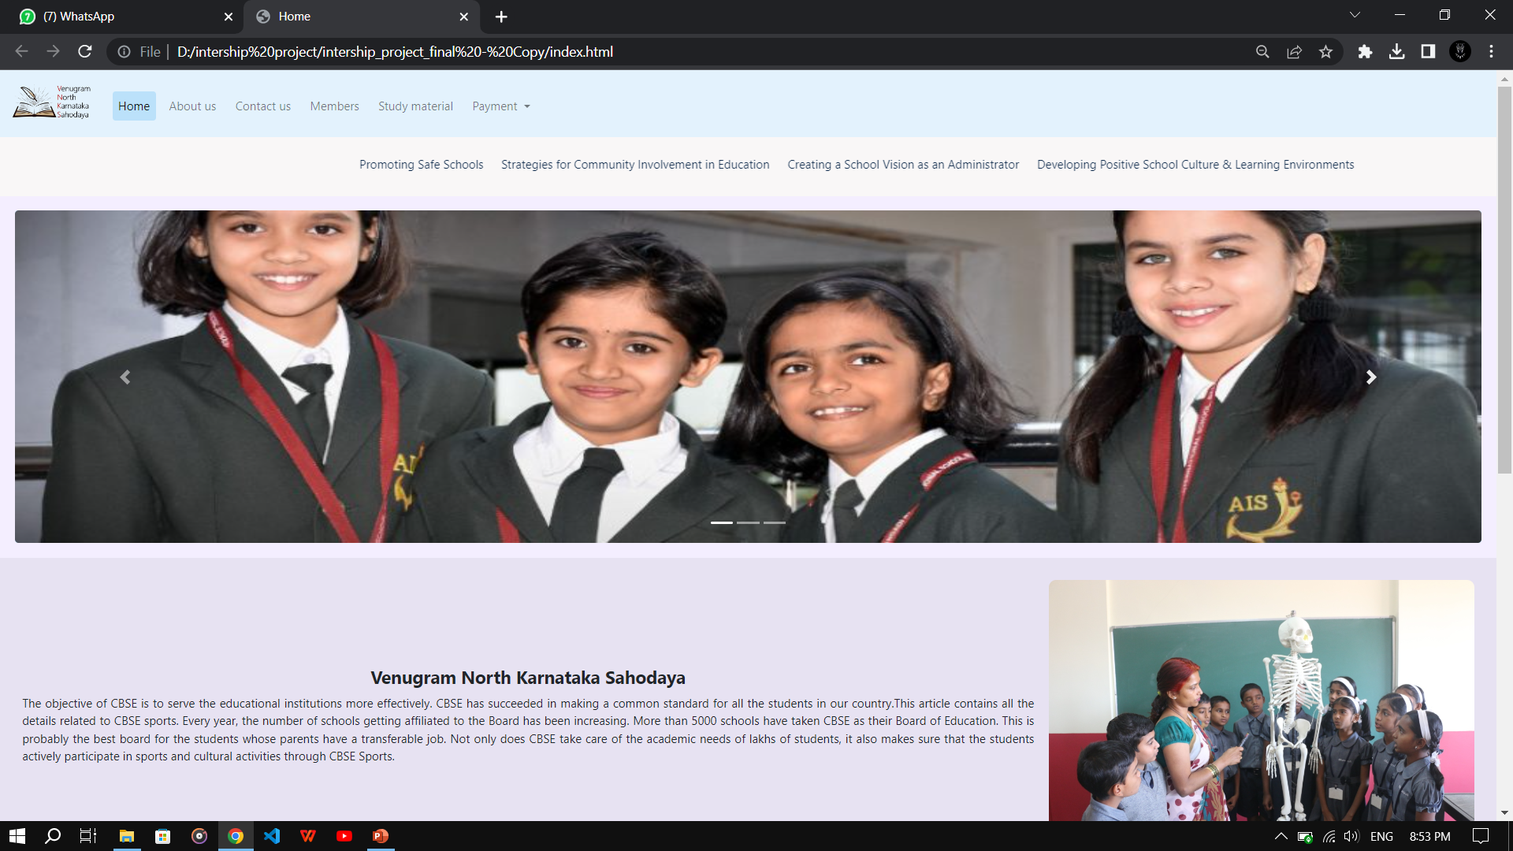
Results/outcome

Slide 12
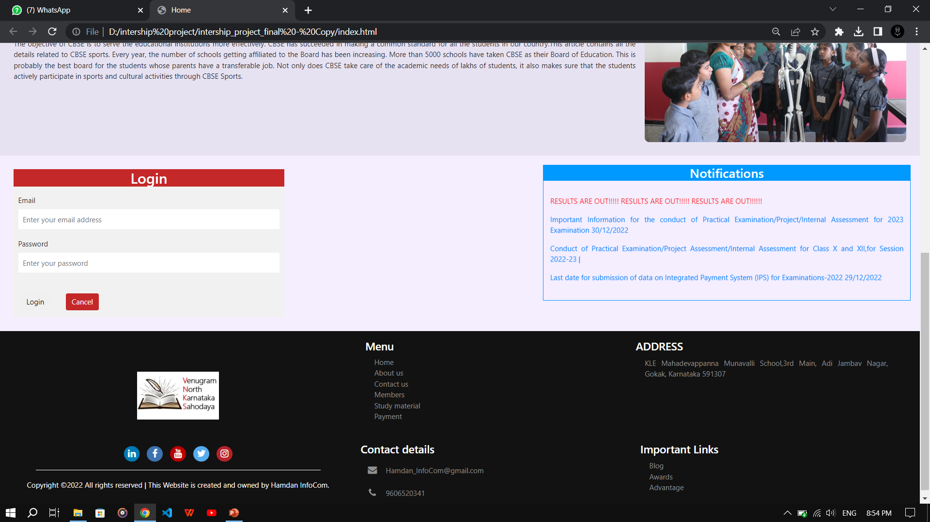
Results/outcome

Slide 13
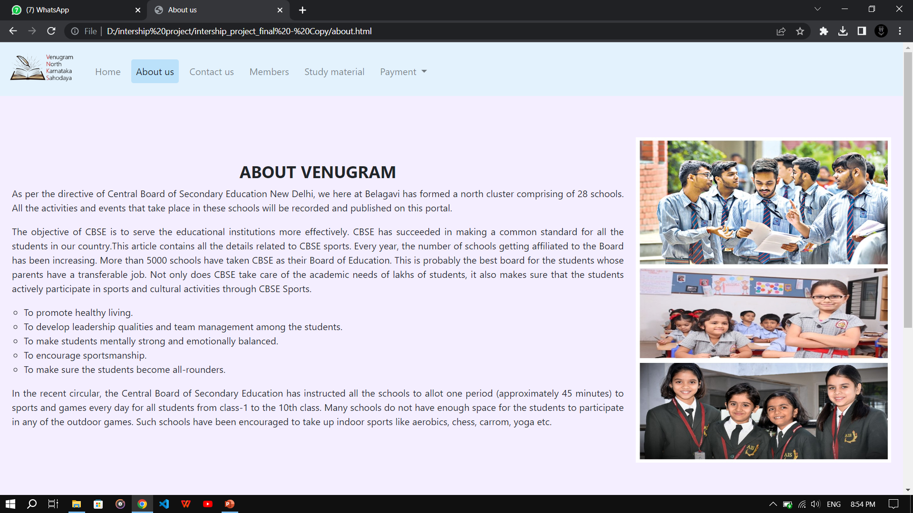
Results/outcome

Slide 14
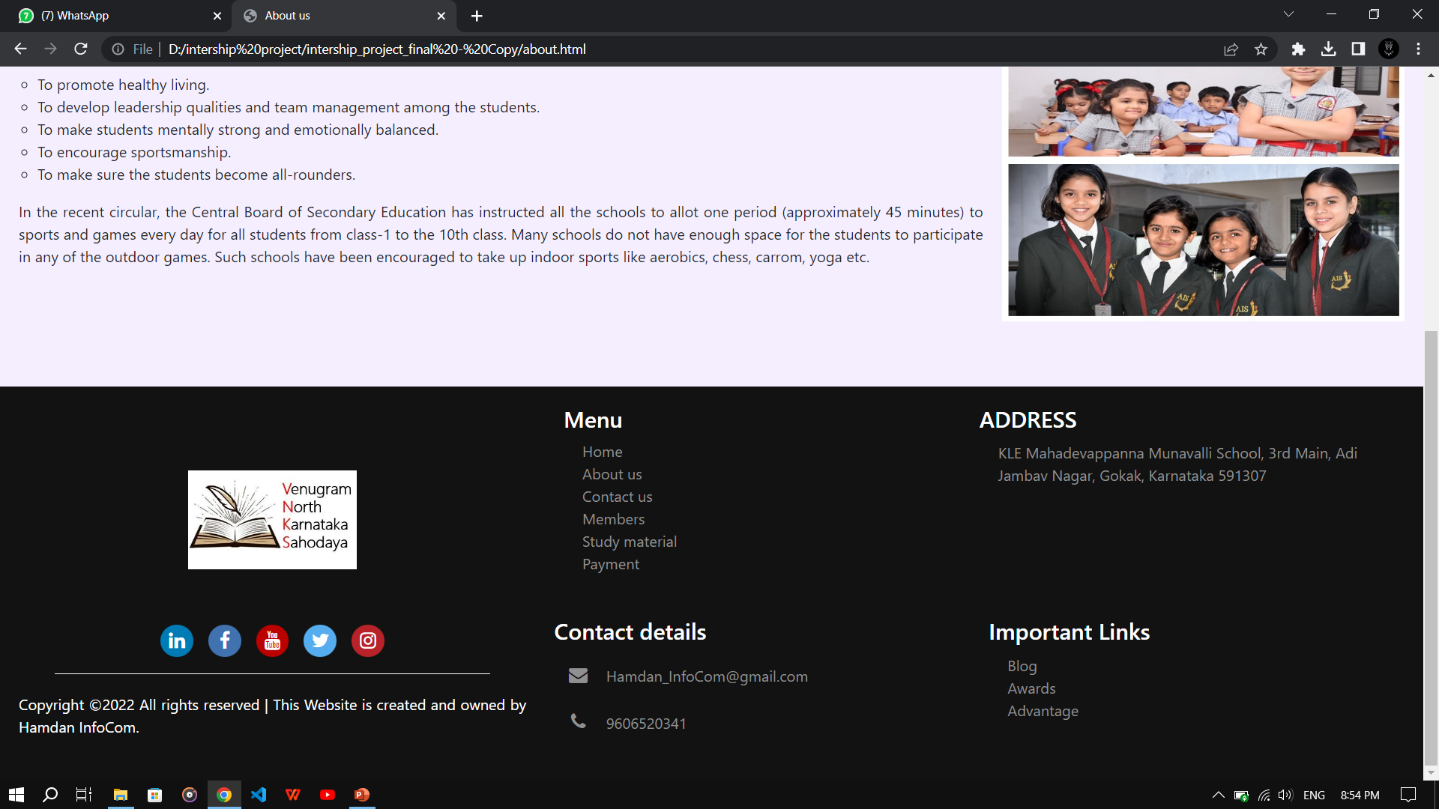
Results/outcome

Slide 15
Advantages
Wide Reach: With the internet being accessible worldwide, websites have a vast reach, and they can target a broad audience with ease.
Cost-Effective: Building a website is relatively cheaper than other forms of advertising, such as print, TV, or radio.
Easy to Update: Websites are easy to update and maintain.
Customizable: A website can be customized to meet the needs of a specific business.

Slide 16
Disadvantages
Security: Web development involves handling sensitive data, and websites are vulnerable to cyber-attacks, which can lead to data breaches.
Technical Complexity: Building and maintaining websites require technical expertise, and web developers need to stay up-to-date with the latest technologies.
Compatibility Issues: Websites need to be compatible with different browsers and devices, which can be challenging.
Slow Load Times: Websites that are slow to load can negatively impact user experience, leading to a higher bounce rate.

Slide 17
Applications
Building visually appealing and interactive websites.
Developing responsive web designs that work well on a range of devices, including desktops, laptops, tablets, and smartphones.
Optimizing web pages for search engine ranking, accessibility, and performance.
Developing web applications that allow users to perform simple tasks.
Maintaining and updating existing websites and web applications to ensure they remain relevant and effective.

Slide 18
Conclusion and Future scope
Front-end web development is the process of creating websites and web applications that can be accessed through the internet.
Front-end web development has evolved over the years, and new technologies and frameworks are continually being introduced to improve the web development process.
Some of the most commonly used technologies and frameworks include HTML, CSS, JavaScript, Bootstrap.

Slide 19
Future Scope
Increased demand for responsive design: As more and more people access the internet through mobile devices, responsive design will become even more important.
Adoption of new front-end frameworks: The front-end development community is constantly developing new frameworks and libraries to make the development process faster and more efficient.
Greater emphasis on accessibility: Web accessibility is becoming increasingly important, and front-end developers will need to ensure that their web pages and applications are accessible to all users, including those with disabilities.

Slide 20
Internship Discussion
HTML: HTML (Hypertext Markup Language) is the standard markup language used to create web pages.
CSS: CSS (Cascading Style Sheets) is used to style and format web pages. We learnt how to use CSS to control the layout, typography, and colors of web pages.
JavaScript: JavaScript is a programming language used to create dynamic and interactive web pages.
Bootstrap: It is a popular front-end framework that makes it easy to create responsive and mobile-first web pages and applications.
Responsive Design: Responsive design is a technique used to create web pages that adjust to different screen sizes and devices.

Slide 21
Challenges Faced During the Internship
The biggest challenge faced in front-end designing is evaluation of end-user requirements and optimizing the design accordingly.
Browser Compatibility: Web pages and applications must work consistently across different browsers and devices. It can be challenging to ensure that web pages are compatible with all major browsers and devices.
Responsive Design: Responsive design is an essential aspect of front-end web development, and we must learn how to design and develop web pages that work well on different screen sizes and devices.

Slide 22
References
C. Fu, "Exploration of Web front-end development technology and optimization direction[C]", International Conference on Electronics Network and Computer Engineering, 2016.
Y. Feng and N J. Chen, "Scheme of Mobile Web Front-end Display Based on MVVM Framework[J]", Computer & Modernization, 2016.
W. S. Zhang and H. Chen, "The Research and Application of Web Front-end Based on MVCS Mode[J]", International Journal of Future Generation Communication & Networking, vol. 8, no. 1, pp. 11-20, 2017.
B. M. Steyer and V. Softic, AngularJS: Moderne Webanwendungen und Single Page Applications mit JavaScript[J], 2017.
S K. Patel, Developing Responsive Web Applications with AJAX and jQuery[J], 2018.
S. Murugesan, Y. Deshpande, S. Hansen et al., Web Engineering: a New Discipline for Development of Web-Based Systems[J], 2018

Slide 23


